Slide 1

CSC 533: Privacy in the Digital Age (Fall 2020) Lecture 23: Bitcoin and Privacy
Anupam Das
Nov. 5, 2020

Slide 2
Goals:
What is bitcoin?
How bitcoin works?
Privacy issues in bitcoins
Many slides contents been taken from Aggelos Kiayias

Slide 3
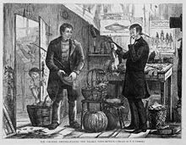
Case study: Money
What is Money?
(1874) A man offering chicken for a yearly newspaper subscription
a medium of exchange
Stands in for an arbitrarily long chain of barter.
a unit of account
Fungible, Divisible
a store of value
Stable supply, Durable, Securable, Stable value

Slide 4
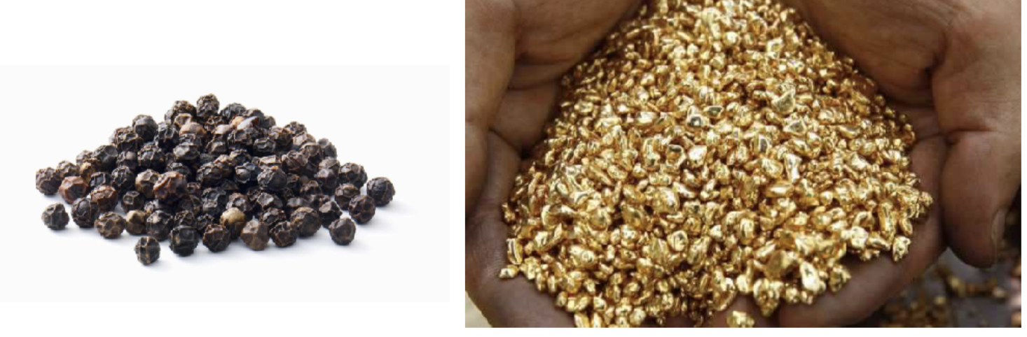
Creating Money
Money 1.0 : using a trusted object (commodity money)

Slide 5
Analysis of Money 1.0
a medium of exchange
a unit of account
a store of value
mediocre [ok for face to face transactions ]
mediocre fungible, but not divisible well. typically forgeable.
bad. some objects may deteriorate, others may have unknown hidden quantities.

Slide 6

Creating Money
Money 2.0 : using a trusted entity (fiat money)
Has no intrinsic value
Backed by government law and regulation
Example: Paper money

Slide 7
Analysis of Money 2.0
a medium of exchange
a unit of account
a store of value
good [for transactions within the domain of the trusted entity]
great! fungible & divisible.
mediocre [tied to the availability & reputation of the issuing entity]

Slide 8
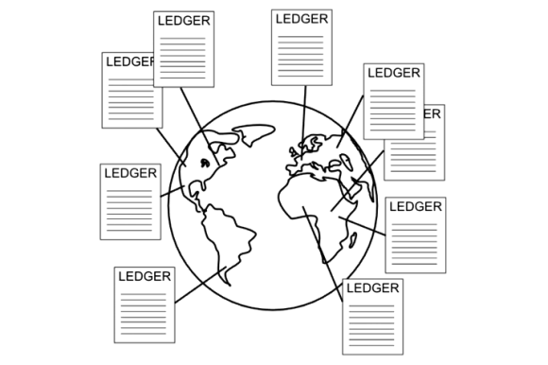

Creating Money
Money 3.0 : Bitcoin
Completely decentralized and distributed (run by volunteers)
Pseudonymous nature
Open to all
Irreversible
Enter Blockchains & Distributed Ledgers

Slide 9

Distributed ledger
A “book” of all transactions
Each new page requires some effort to produce.
Anyone can be a scribe and produce a page.
New pages are produced indefinitely as long as scribes are interested in doing so.

Slide 10
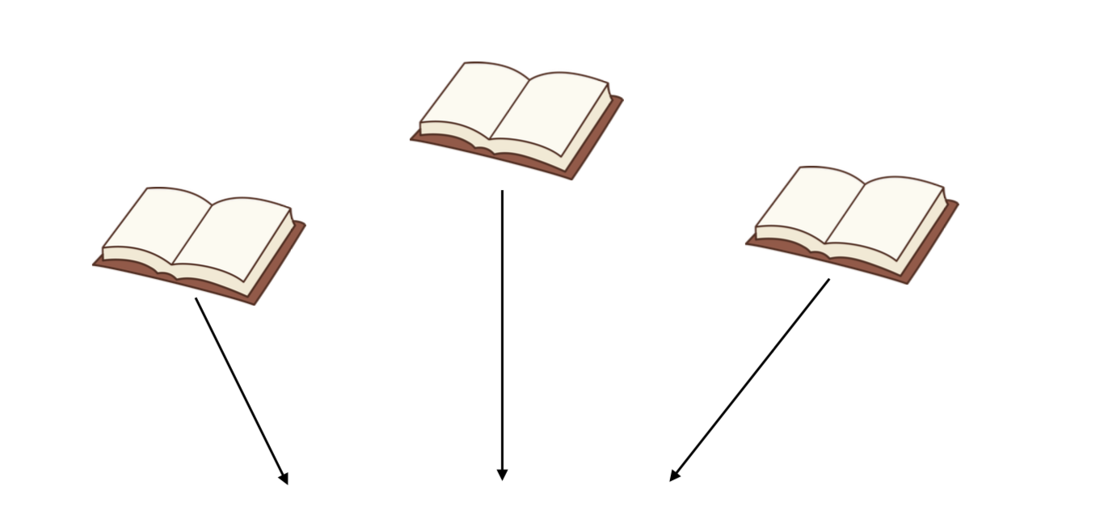
Importance of Consensus
If multiple conflicting books exist, which is the “right one”?
The book with the most pages. if multiple exist, just wait to get a book with a higher page count.

Slide 11
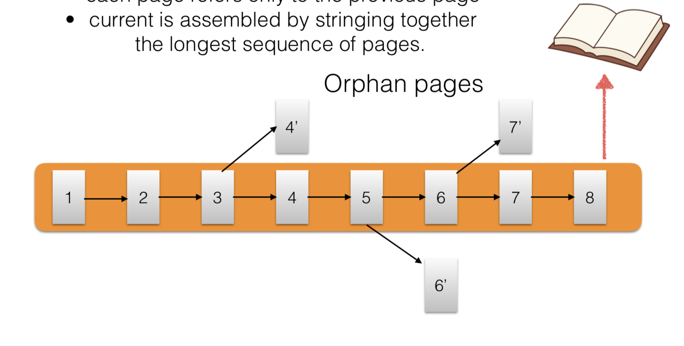
Assembling the current book
each page refers only to the previous page
current status is assembled by stringing together the longest sequence of pages

Slide 12
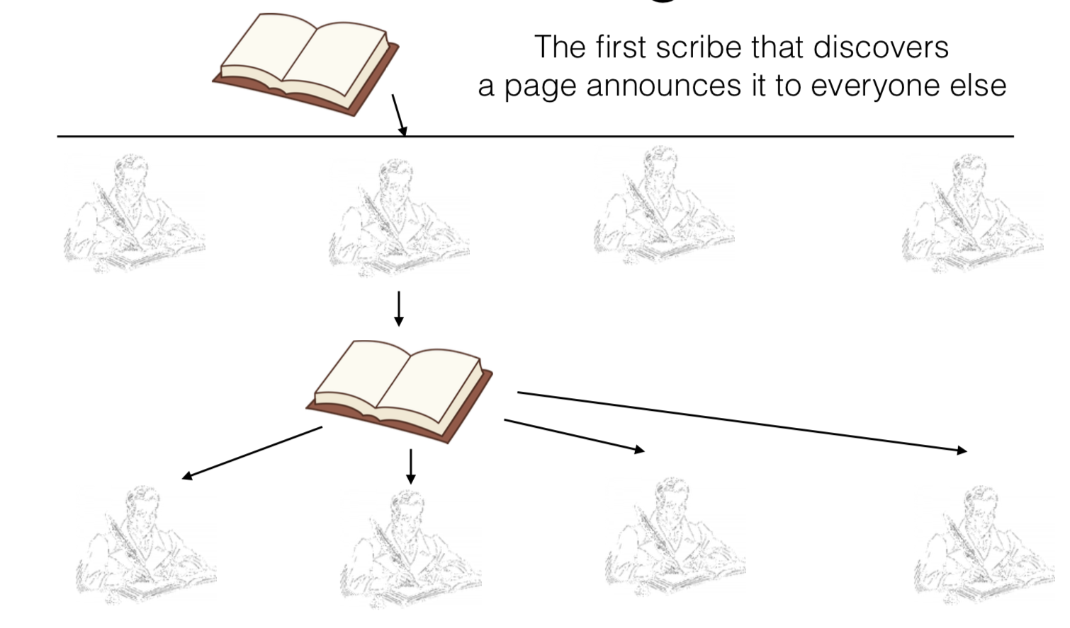
Rules of extending the book
The first scribe that discovers a page announces it to everyone else

Slide 13
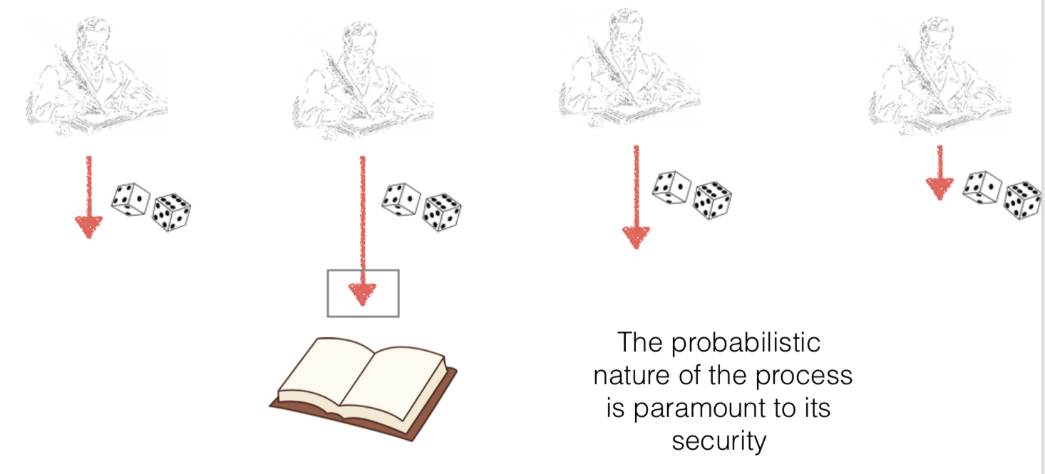
Effort is needed to produce a page
equivalent to: each page needs a special combination from a set of dice to be rolled.

Slide 14
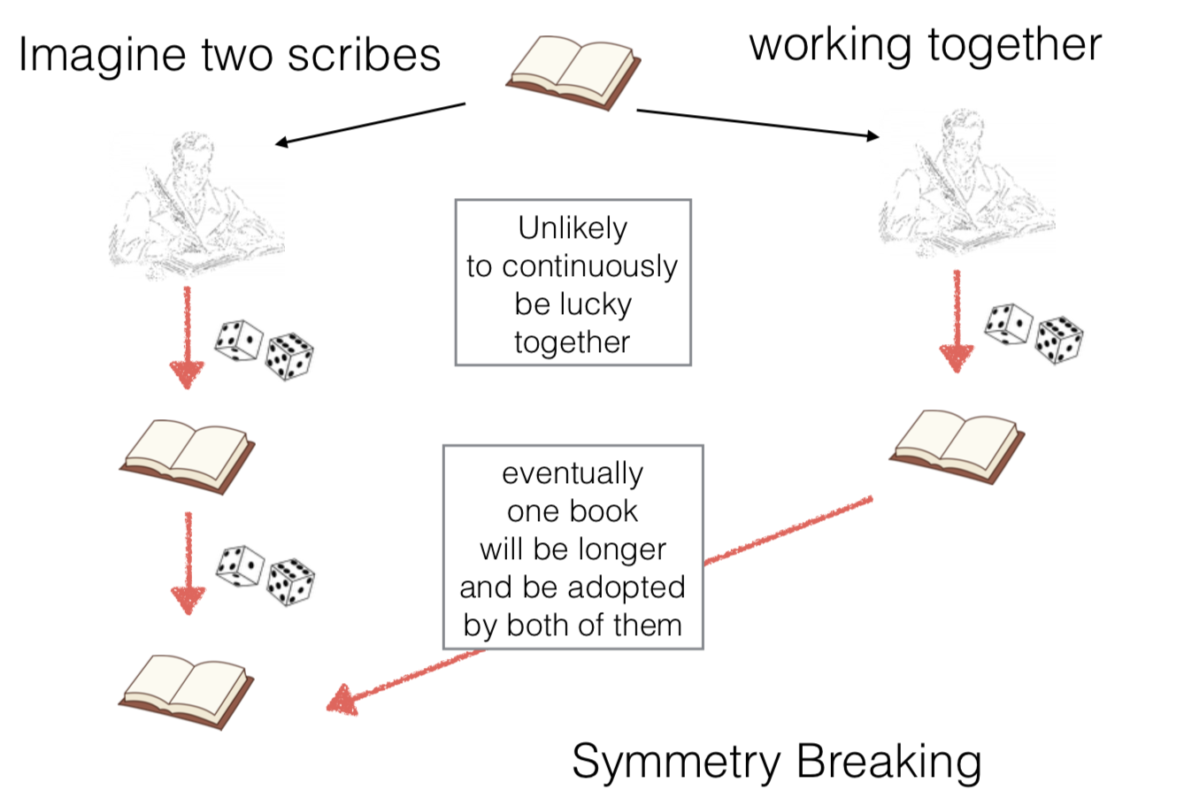
The benefits of randomness

Slide 15
Being a scribe
Anyone can be a scribe for the book.
As long as one has a set of dice.
The more dice one has, the higher the likelihood to produce the winning combination to make a page.

Slide 16
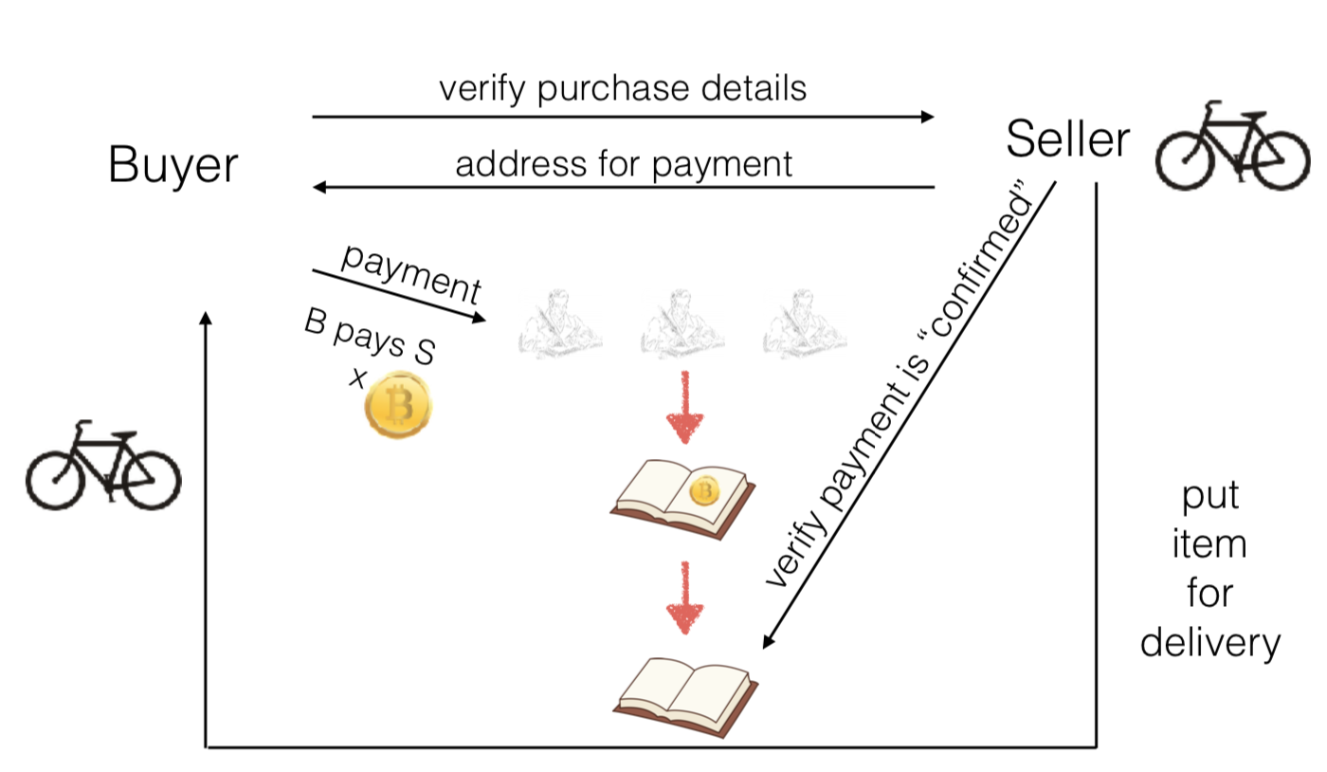
Using the book - Money 3.0
1
2
3
4
5

Slide 17
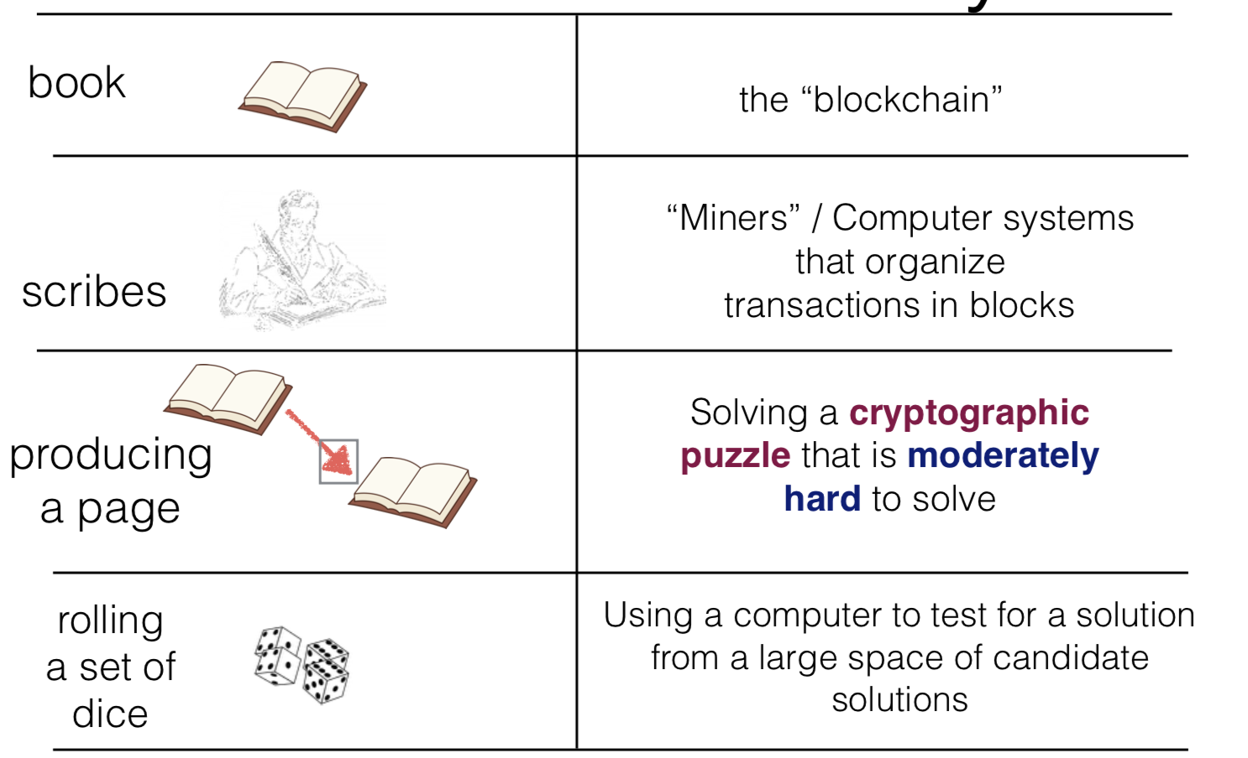
Analogy vs. Reality

Slide 18
Analysis of Money 3.0
a medium of exchange
a unit of account
a store of value
improving [assuming internet connectivity / adoption]
great! fungible & divisible.
good [no trusted parties - no natural deterioration]

Slide 19
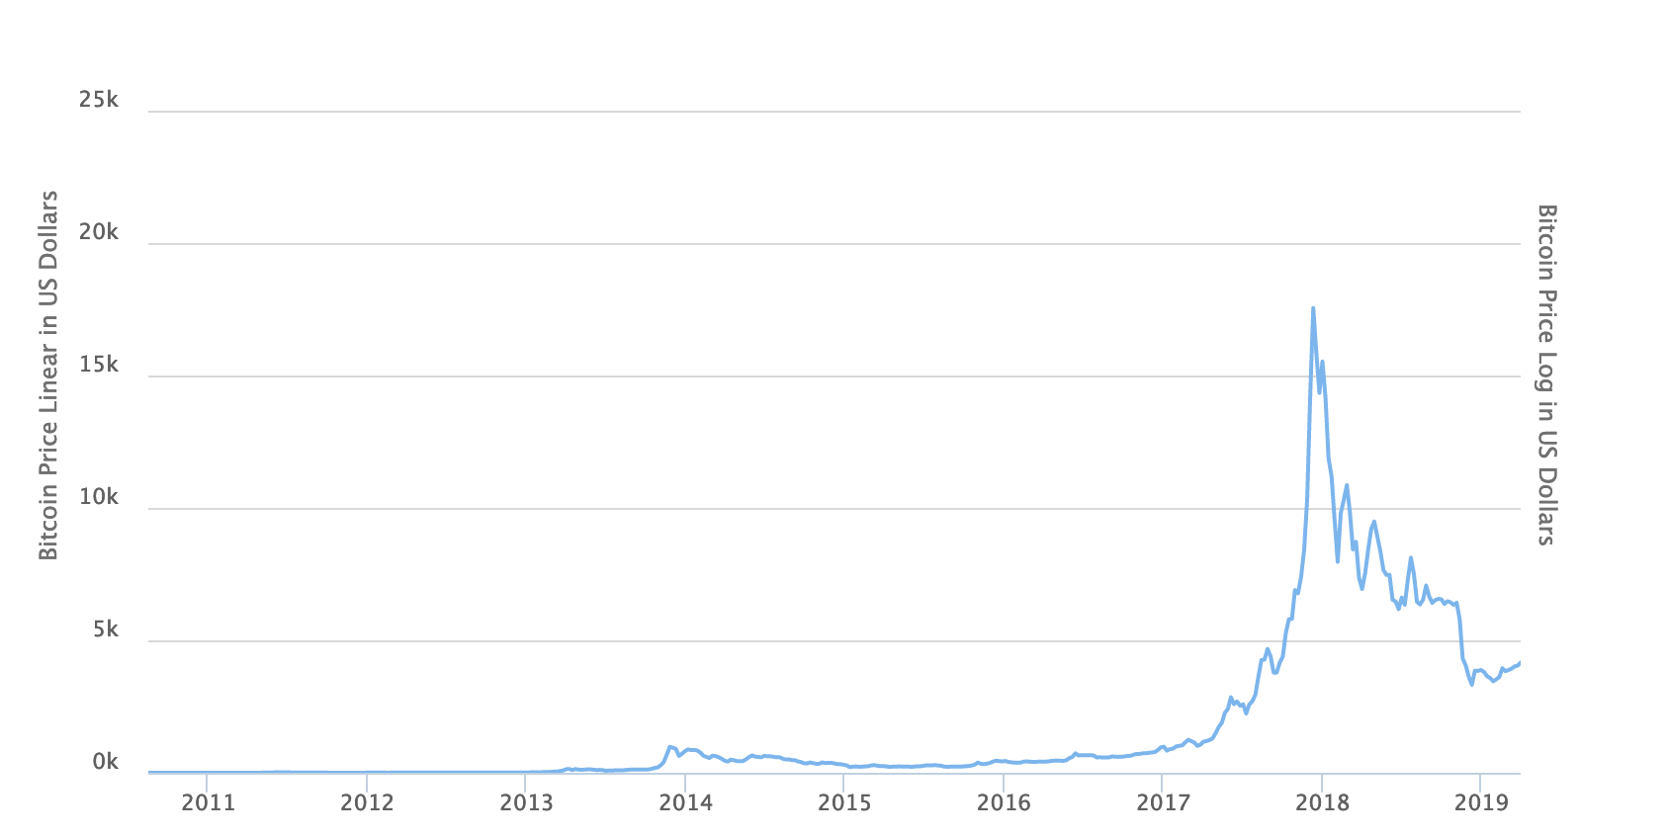
Word of caution
Just because something can be good as a store of value, it does not mean that it will be a good store of value in a real world deployment.

Slide 20
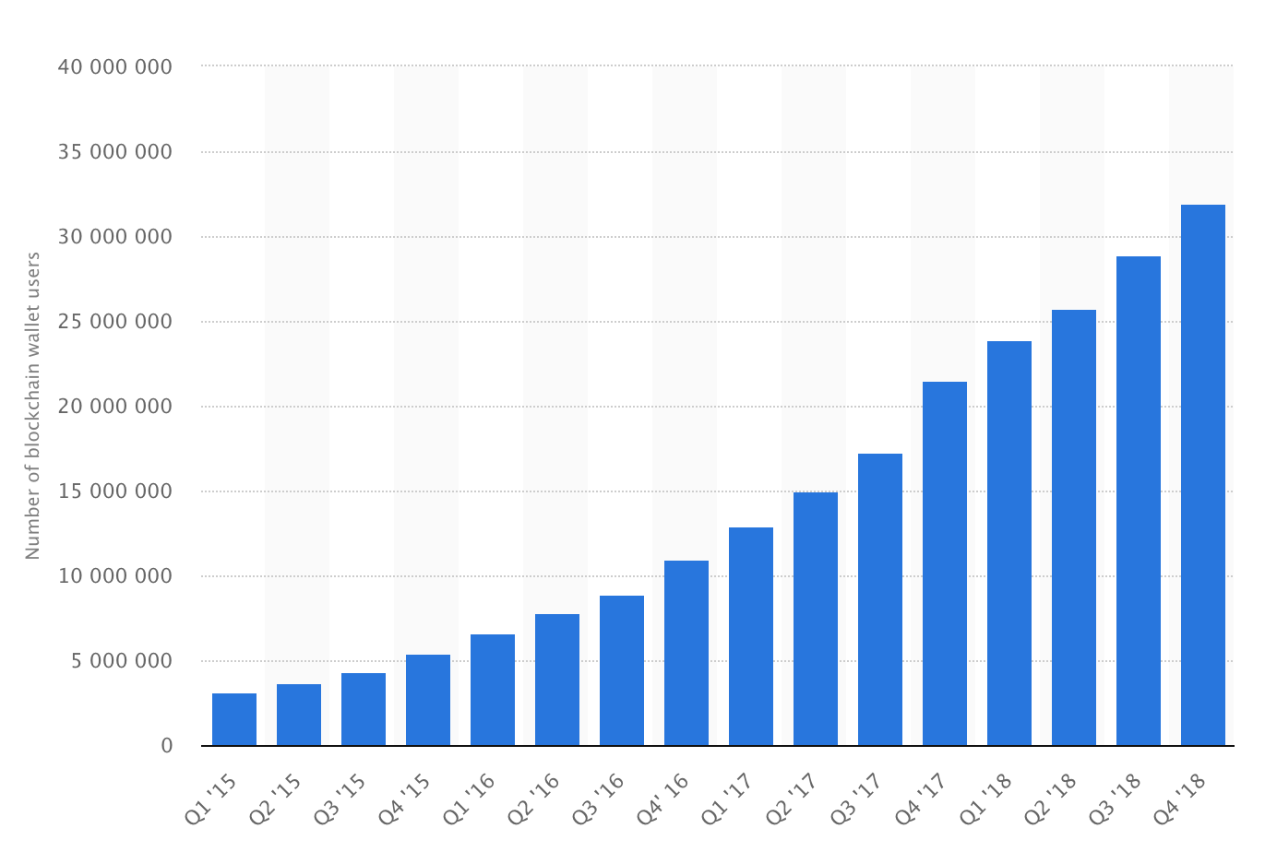
Bitcoin growing: Accounts in bitcoin
Users can create accounts practically without cost and without association to previous accounts

Slide 21
Two important properties to remember
Tamper resistant
Cryptographic protocols (Hashed block chain)
No double spending
Distributed consensus

Slide 22
Hash
Hash function:
takes any string as input
fixed-size output (we’ll use 256 bits)
efficiently computable
Security properties:
collision-resistant
hiding
puzzle-friendly
22

Slide 23
Hash property 1: Collision-resistant
Difficult to find x and y such that
x != y and H(x)=H(y)
x
H(x) = H(y)
y
23

Slide 24
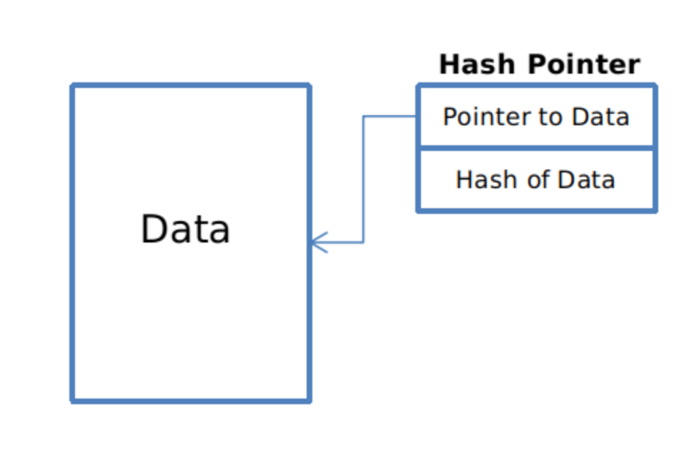
Hash pointers
hash pointer is:
* pointer to where some info is stored, and
* (cryptographic) hash of the info
if we have a hash pointer, we can
* ask to get the info back, and
* verify that it hasn’t changed
H( )
(data)
will draw hash pointers like this
24

Slide 25
Blockchain of hash pointers
H( )
linked list with hash pointers = “block chain”
prev: H( )
prev: H( )
prev: H( )
data
data
data
use case: tamper-evident log
25

Slide 26
Detecting tampering
H( )
prev: H( )
prev: H( )
prev: H( )
data
data
data
use case: tamper-evident log
26

Slide 27
How does blocks get added?
https://youtu.be/bBC-nXj3Ng4?t=609

Slide 28
What can a malicious node do?
Alice pays bob
Double-spending attack
signed by A
C_{A} → B
Pay to pk_{B} : H( )
signed by A
C_{A} → A’
Pay to pk_{A’} : H( )
Works only if 50% of the nodes are honest
Alice pays Alex too
Honest nodes will extend the longest valid branch
Notes:
Can’t create new transactions from someone else’s address, or modify them.
Suppressing tx’s is only a minor annoyance.

Slide 29
From Bob the merchant’s point of view
1 confirmation
3 confirmations
C_{A} → B
Double-spend probability decreases exponentially with # of confirmations
Most common heuristic: 6 confirmations
C_{A} → A’
double-spend attempt
Hear about C_{A} → B transaction
0 confirmations

Slide 30
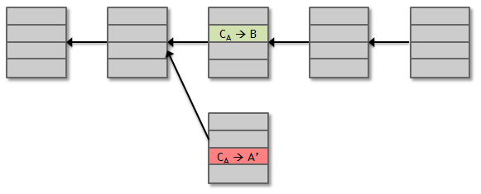
Recap
Protection against invalid transactions is cryptographic, but enforced by consensus
Protection against double-spending is purely by consensus
You’re never 100% sure a transaction is in consensus branch. Guarantee is probabilistic

Slide 31
What about privacy in Bitcoin?
Can we track who is sending to who?
Yes, why?
Bitcoin provides psuedonymity, but not unlinkability.
Pseudonymity: Everything is public but identities are substituted by tags that are independently assigned to each identity.
Bitcoin provides psuedonymity, but not anonymity!

Slide 32
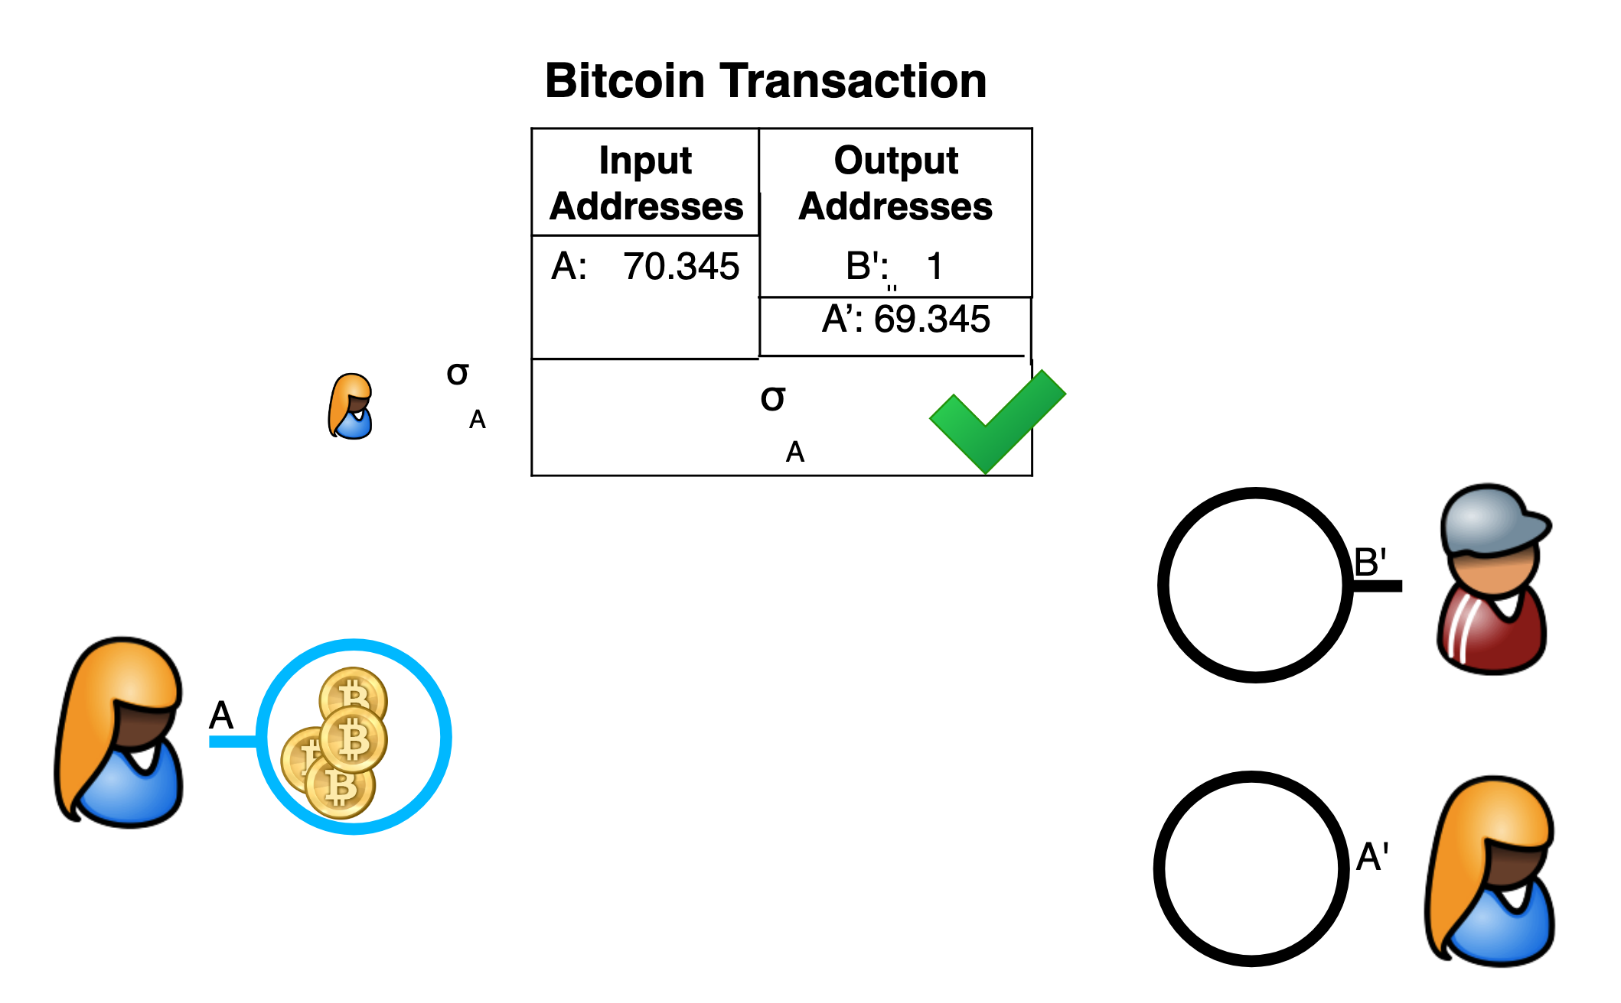
Sample transaction

Slide 33
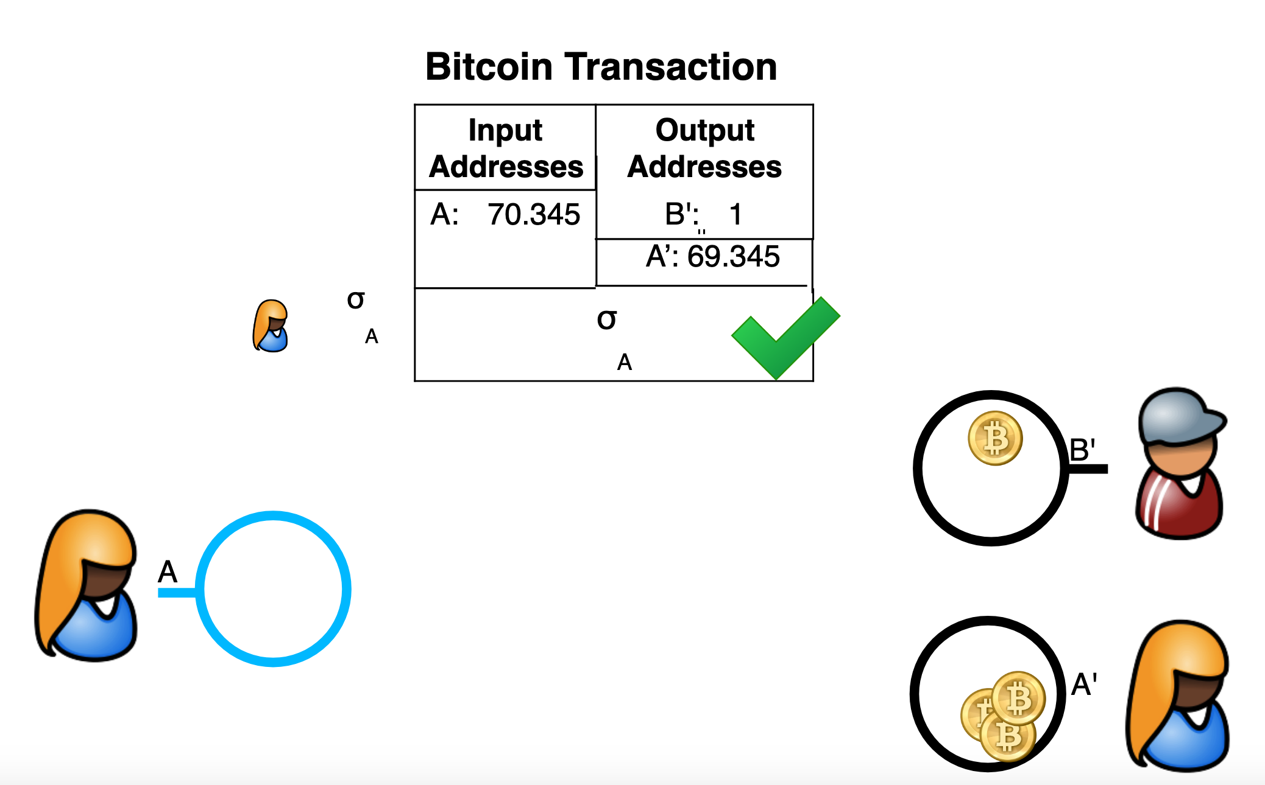
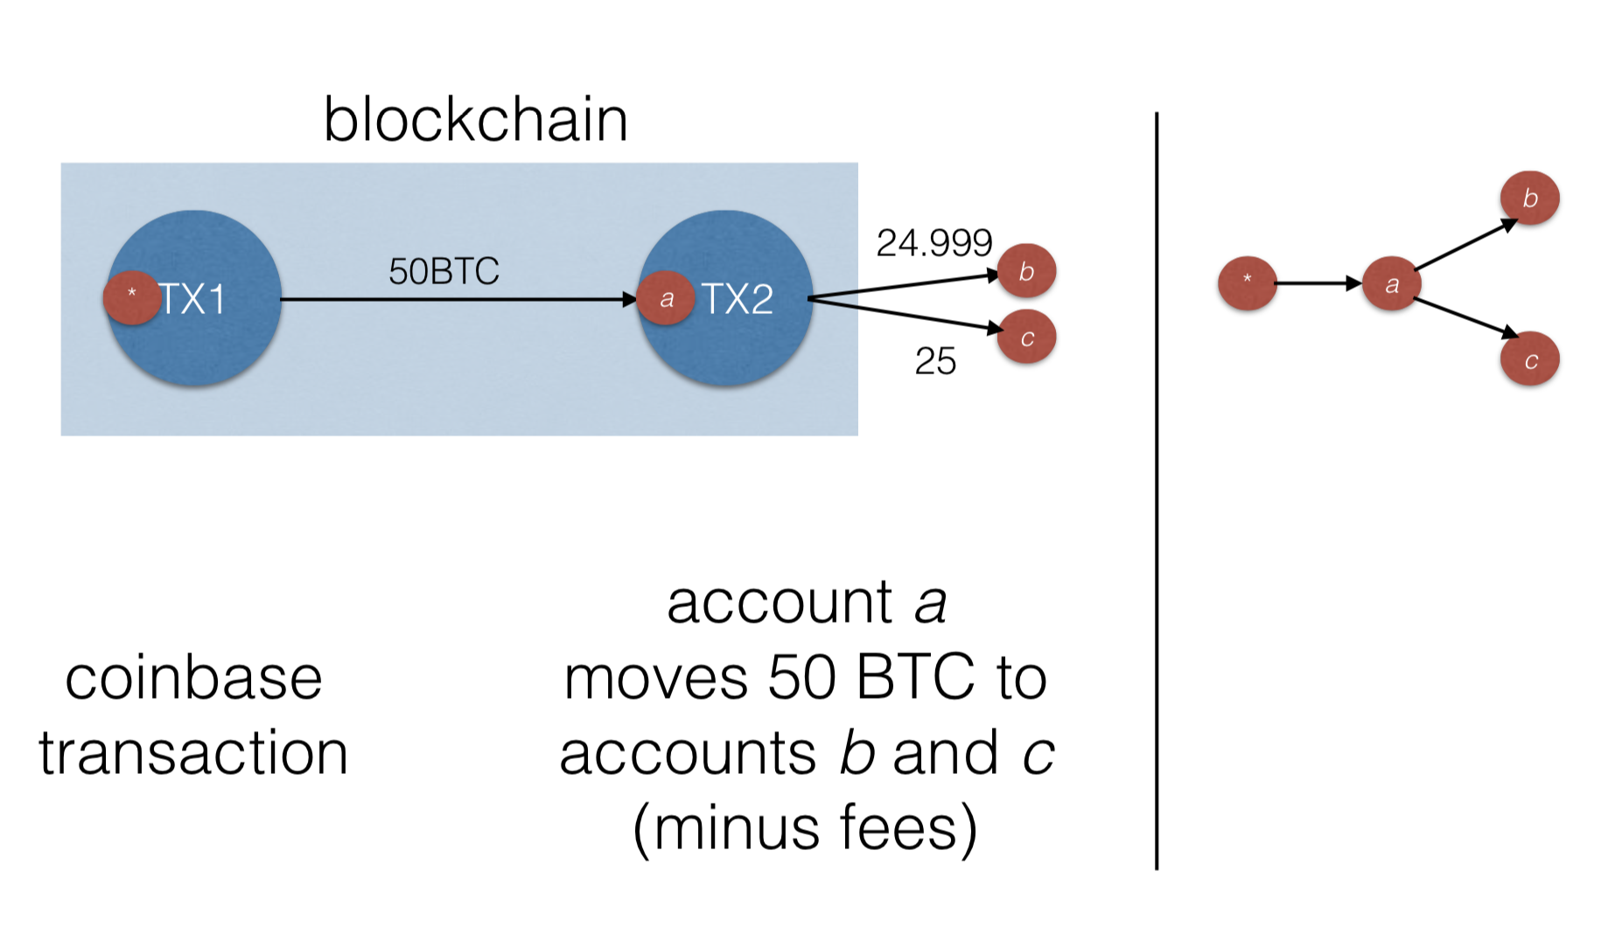
Transaction graph is visible

Slide 34
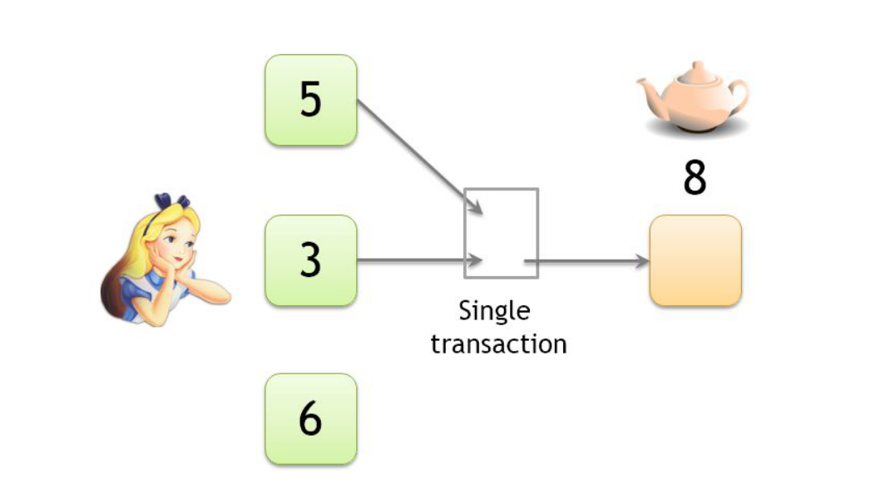
Linking pseudonyms
Both inputs must belong to the same person
The wallet will require the keys to generate the transaction
Lecture: https://youtu.be/glyQy_e5LmM?t=1758

Slide 35
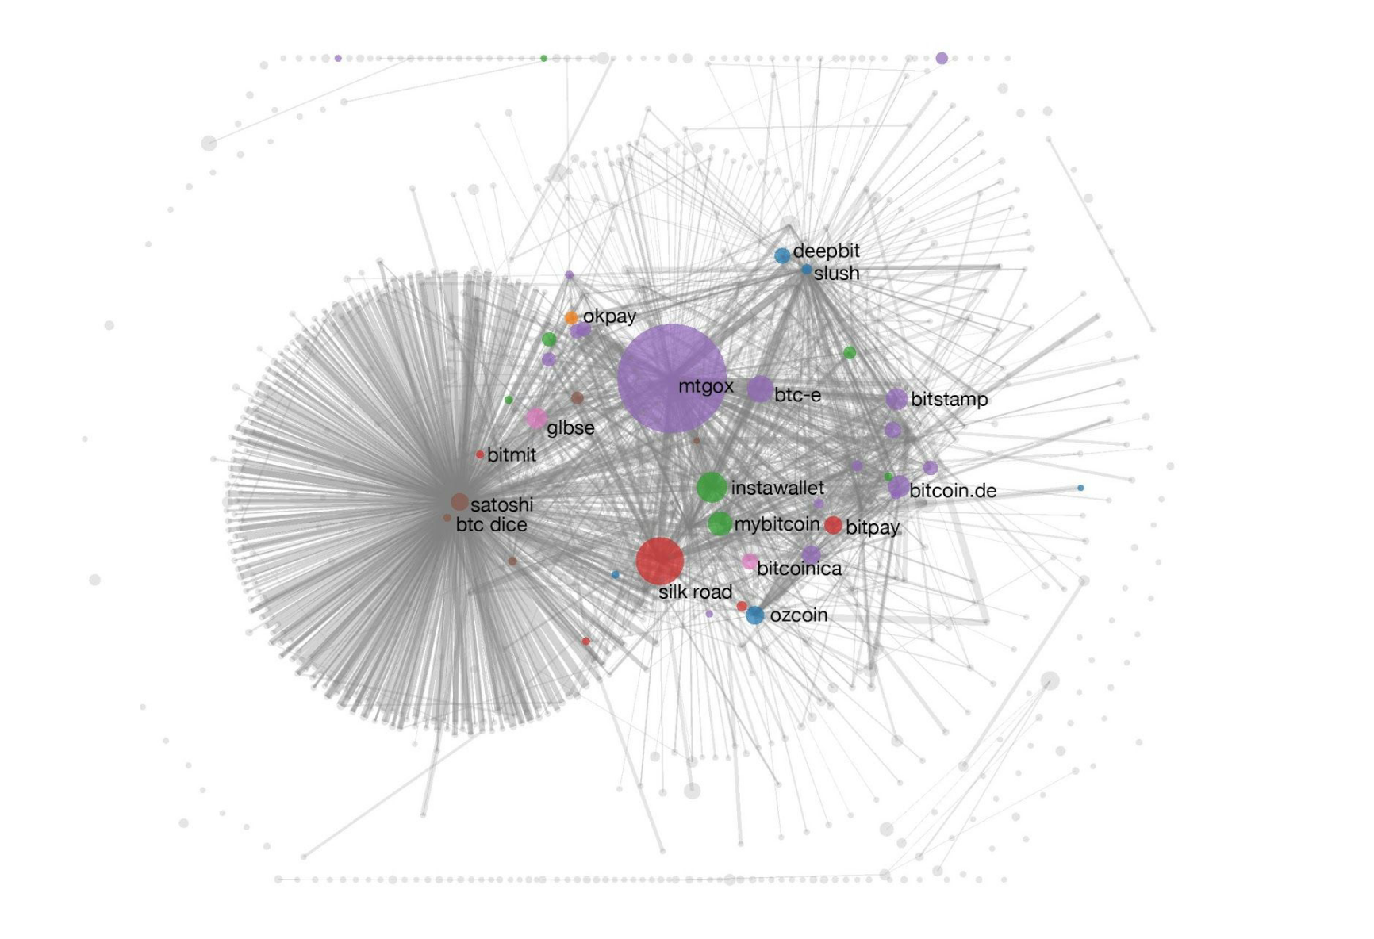
Deanonymization attacks
Transaction graph (plus side channel information) can link pseudonyms to real/online identities
​Paper: A Fistful of Bitcoins: Characterizing Payments Among Men with No Names

Slide 36
Key Approaches for Blockchain Privacy
Many approaches:
Mixing (Coinjoin mixing and third-party Mixing)
Zerocoin
Ring Signatures
Stealth Addresses
Additive Homomorphic Commitments with Range Proofs
Zero-Knowledge Succinct Non-interactive Arguments of Knowledge (ZK-SNARKs)
Not everything works with every blockchain!

Slide 37
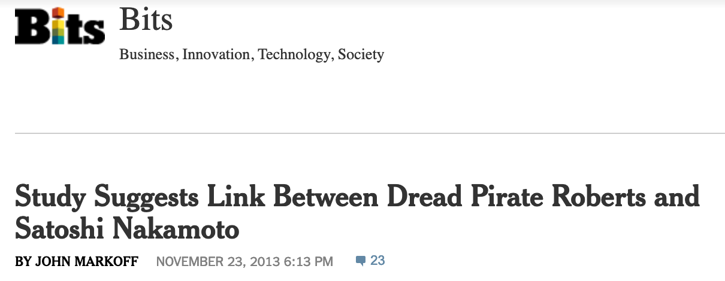
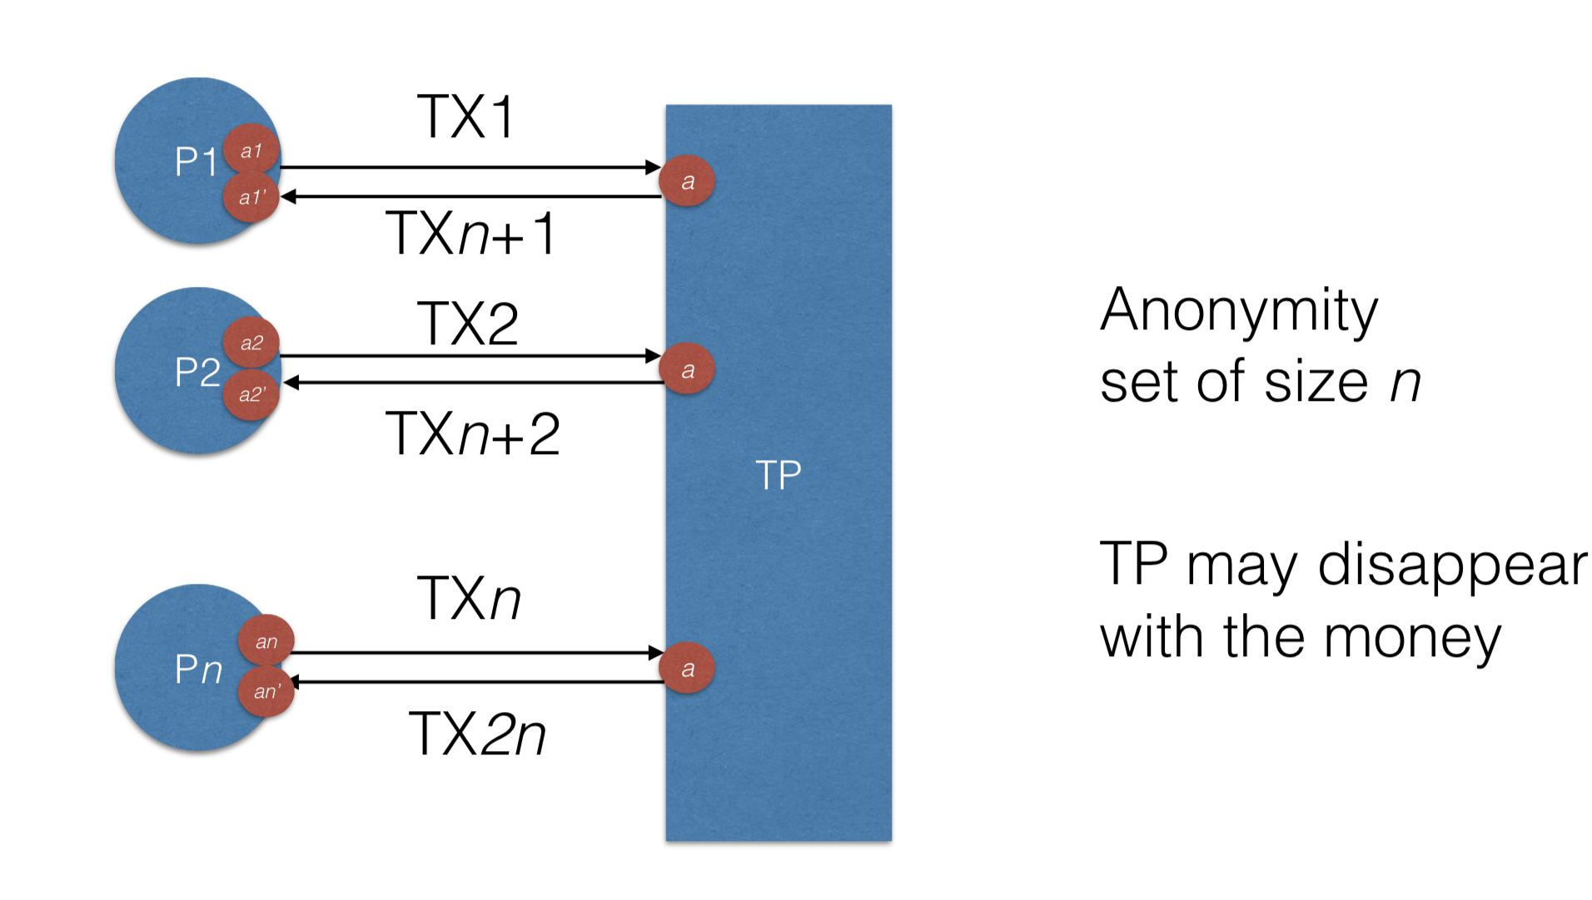
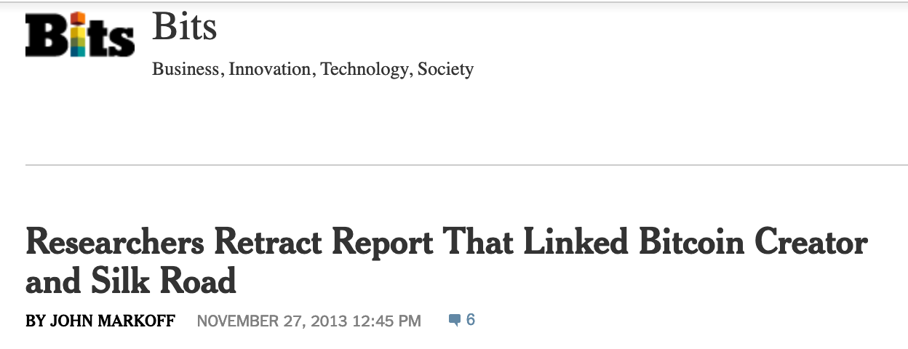
Anonymizing Transactions (intermediary)

Slide 38
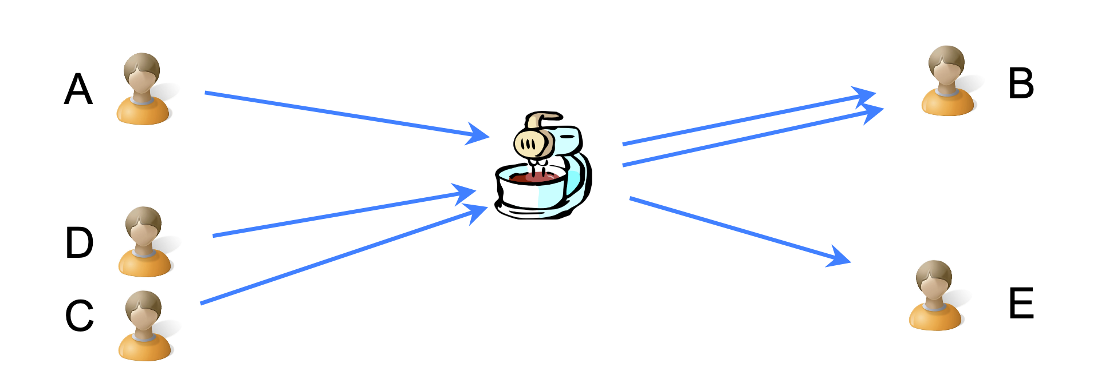
Mixnet approach
(Better!?) Relationship Anonymity
No Value Privacy
No co-ordination is required
Examples: MixCoin, Blindcoin, TumbleBit

Slide 39
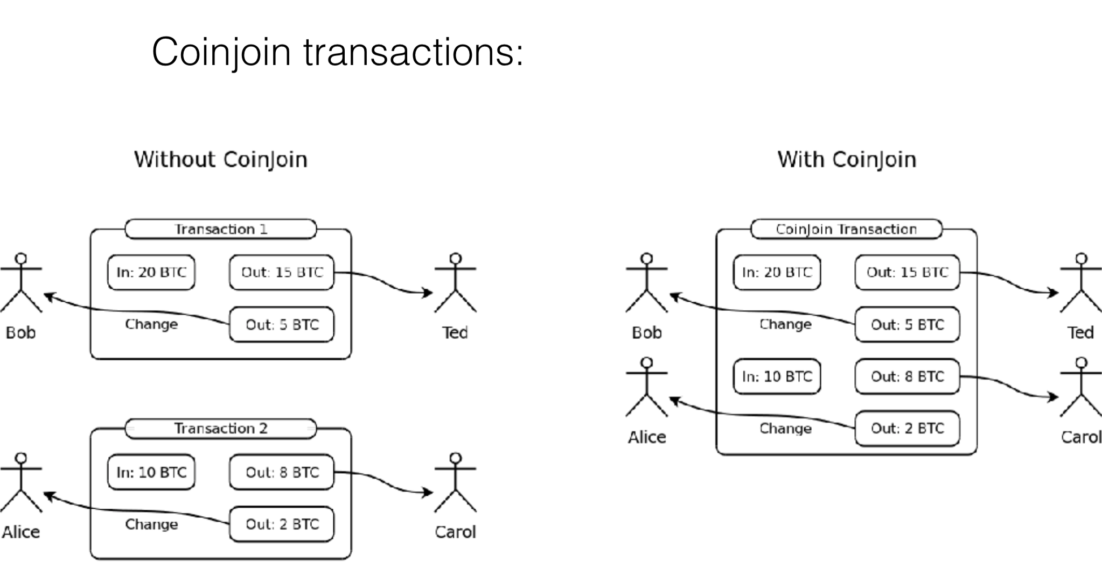
Coinjoin (Decentralized mixing)
Find peers who want to mix
Exchange input/output addresses
Construct transaction
Send the transaction around. Each peer signs after verifying their output is present.
Broadcast the transaction
Relationship Anonymity
No Amount/Value Privacy
Examples: CoinShuffle, Coinparty, XIM, CoinShuffle++
Lecture: https://youtu.be/glyQy_e5LmM?t=4094

Slide 40
Zerocoin
A distributed approach to private electronic cash
Extends Bitcoin by adding an anonymous currency on top of it
Zerocoins are exchangeable for bitcoins
Uses zero-knowledge proofs
An approach for somebody to prove a (mathematical) statement without revealing any other information that leads to that statement being true.
E.g., you can also prove a statement such as “I know x such that H(x) belongs to the following set: {...}”.The proof would reveal nothing about x, nor about which element of the set equals H(x).

Slide 41
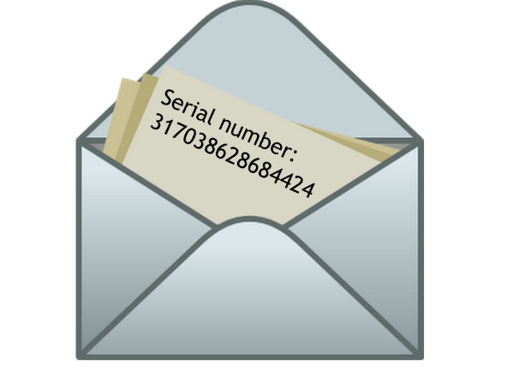
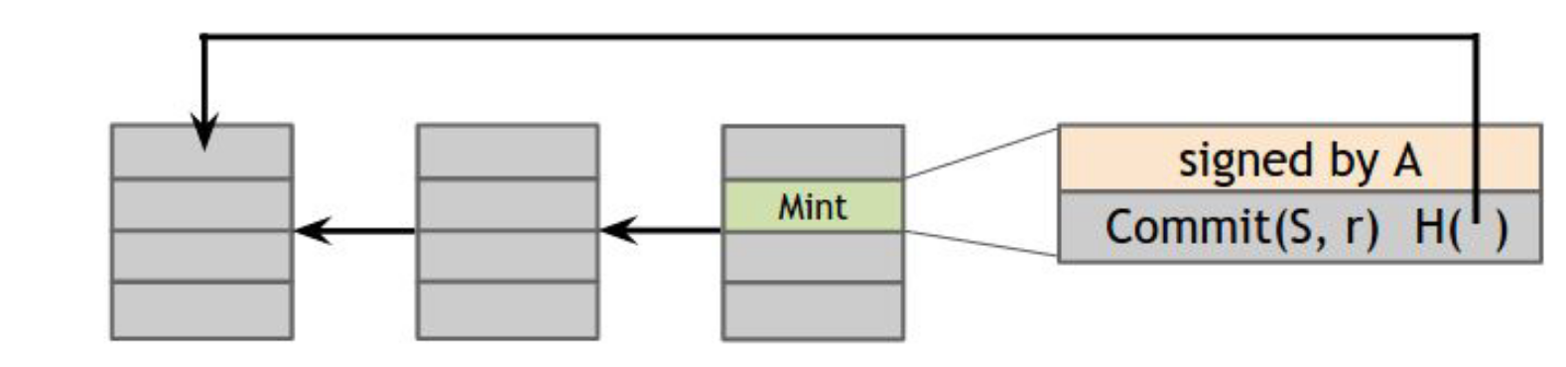
Minting a Zerocoin
Anyone can make one
Choose a random serial number and commit to it
Generate serial number ​S​ and a random secret ​r
Compute ​Commit(S, r)​, the commitment to the serial number. It is basically H(S, r)
Publish the commitment onto the block chain
A mint transaction in the block chain which “spends” a bitcoin and includes the commitment
Spending a zerocoin gives the recipient a bitcoin
Mint transaction

Slide 42
Spending Zerocoin
Reveal S (miners verify S has never appeared before)
Create a zero-knowledge proof that:
I know a number r such that H(S,r) is one of the zerocoins in the block chain.
Anonymity
Since r is secret no can figure out which zerocoin corresponds to serial number S.
Properties
Sender/Recipient/Relationship Anonymity
Value Privacy (through Zcash built on top of Zcoin)
Anonymity set is all other private coins
A trusted/distributed setup is required

Slide 43
Key points
Providing the desired level of privacy still an open problem
Blockchain allows for distributed ledger and can be used for many other problems.

Slide 44
Logistics
Great video lectures
https://www.youtube.com/watch?v=bBC-nXj3Ng4
https://www.khanacademy.org/economics-finance-domain/core-finance/money-and-banking/bitcoin/v/bitcoin-what-is-it
http://bitcoinbook.cs.princeton.edu/ (very nice lecture series!)
Home work #5 due Nov. 6 @11:59pm
Project final Report due Nov. 16 @11:59pm

